Slide 1
DS8003 - Final Project The Complete Journey
Submitted By:-
Akshdeep Kaler
Li Gong

Slide 2
Problem
The retail stores sell products to customers, and they would like to retain their customers and sell more items. For that purpose, various campaign strategies were launched. To know if the employed strategy is working, it is important to know that what elements of the strategy steer the business in right direction and which of them are not producing the desired output.
Proposed Solution
By answering following questions:
1. What are the characteristics of customers whose spending at the store is increasing?
2. What are the categories of the products that are seeing increased/decreased sales?
3. What are the most profitable categories of the products over time?
4. Which day has the highest sales?
5. Are the marketing campaigns effective?
6. Which of the marketing campaigns was the most successful one?
7. What are the characteristics of customers who were attracted by each marketing campaign?
Work Distribution:
(1-4) Akshdeep Kaler
(5-7) Li Gong

Slide 3
Dataset
Title: The Complete Journey, made available by Dunhumby
The dataset contains household level, anonymized, transaction data (2500 households) including the demographics and marketing campaigns (30 campaigns). The transactional data include over 90 thousand products categorized in 44 departments. The dataset is available at https://www.kaggle.com/frtgnn/dunnhumby-the-complete-journey.
Datasets Descriptions:
hh_demographic: The table contains demographic information for a portion of households.
transaction_data: This contains all products purchased by households.
campaign_table: This table lists the campaigns received by each household in the study.
campaign_desc: This table gives the length of time for which a campaign runs. Any coupons received as part of a campaign are valid within dates contained in this table.
product: This table contains information on each product sold such as type of product, national or private label and a brand identifier.
coupon: This table list all the coupons sent to customers as part of a campaign, as well as the products for which each coupon is redeemable.
coupon_redempt: This table identifies the coupons that each household redeemed.
casual_data: This table signifies whether a given product was featured in the weekly mailer or was part of an in-store display (other than regular product placement).

Slide 4
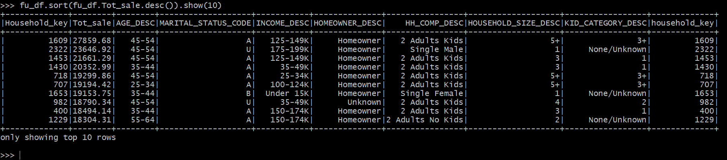
What are the characteristics of customers whose spending at the store is increasing?
Datasets: transaction_data.csv , hh_demographic.csv
Tools:
Hadoop Distributed File System (HDFS) (Storage of data file)
Pyspark (file transformation)
Pyspark SQL (creating table, Querying)

Slide 5
What are the categories of the products that are seeing increased/decreased sales?
Datasets: transaction_data.csv and product.csv
Tools:
Hadoop Distributed File System (HDFS) (Storage)
Hive (Creating Table, Querying)
Output:
The categories which had the lowest sales are Elect&Plumbing, Gro Bakery, Housewares, Meat-WHSE, Prod-WHS Sales, HBC, Toys and Pork.
The categories which has the highest sales are Grocery, Drug GM, Produce, Meat, Kiosk-Gas, Meat-Pckgd, Deli, Pastry, Misc Sales Tran and Nutrition.
What are the most profitable categories of the products over time?
Grocery are most profitable category in the stores with sale of around 4,093,814 dollars.

Slide 6
Which day in two years period has the highest sales?
Datasets: transaction_data.csv
Tools:
Hadoop Distributed File System (HDFS) (Storage)
Hadoop map-reduce (processing)
Output:
The output shows that 641th day of 2-year period had the highest sales of 24,740.1 dollars. The 641th day falls in the month of October.
Insights Description:
Mostly the customers who spend more on the store are of 45-54 year age group are married and have kids. It could be the reason behind the higher sales of the grocery items in the stores.
As the grocery covers around 50% of total sales and store has $24,740.1 dollar of highest sale in a day, the store need to originate up with the more ideas to increase the sales of other product.

Slide 7
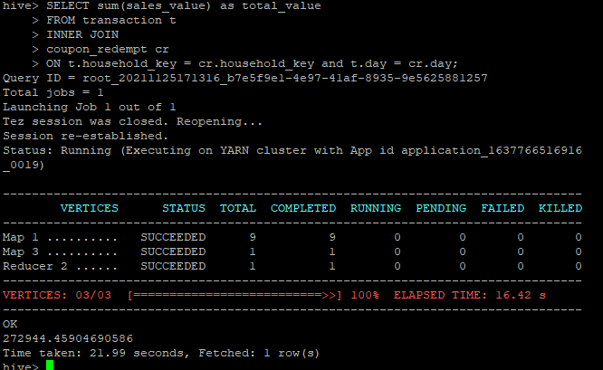
Are the marketing campaigns effective?
Datasets: transaction_data.csv, coupon_redempt.csv
Tools:
Hadoop Distributed File System (HDFS) (Storage)
Hive (Querying)
Compare the purchases with redeemed coupons and without coupons.
Find total sales/quantities of households (transaction_data.csv) who redeemed coupons ( coupon_redempt.csv) -- A
Find total sales/quantities of all households (transaction_data.csv) -- B
Calculate the promotion rate by sales and quantities -- A/B%
Insights:
Marketing campaigns are more effective on higher price products.
Promotion Rate
Sales | 3.3%
Quantities | 1.2%

Slide 8
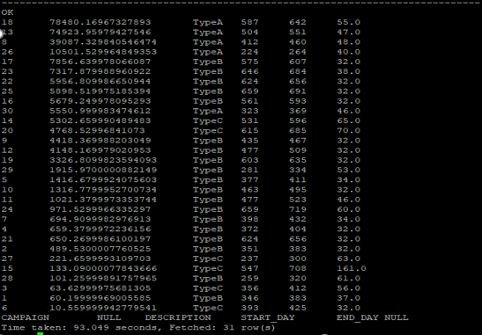
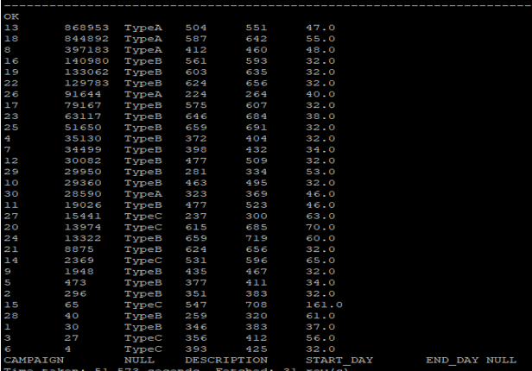
Which of the marketing campaigns was the most successful one?
Datasets: coupon_redempt.csv, campaign_desc.csv, transaction_data.csv
Tools:
Hadoop Distributed File System (HDFS) (Storage)
Hive (Querying)
Compare the campaigns with their redeemed coupons
Aggregate total sales/quantities (transaction_data.csv) of each campaign with redeemed coupons ( coupon_redempt.csv)
Link to campaign information (campaign_desc.csv)
Insights:
No.18 campaign is the best. Top 4
campaigns were mostly type A.
Type B campaigns performed in the
medium level. Type C came last.
Products with higher price are
sensitive to marketing campaigns.
By Sales By Quantities

Slide 9
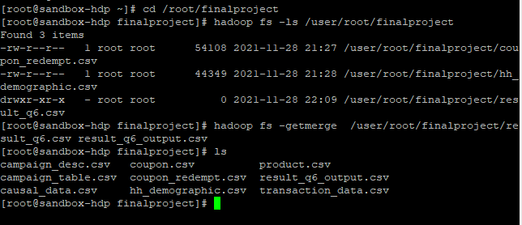
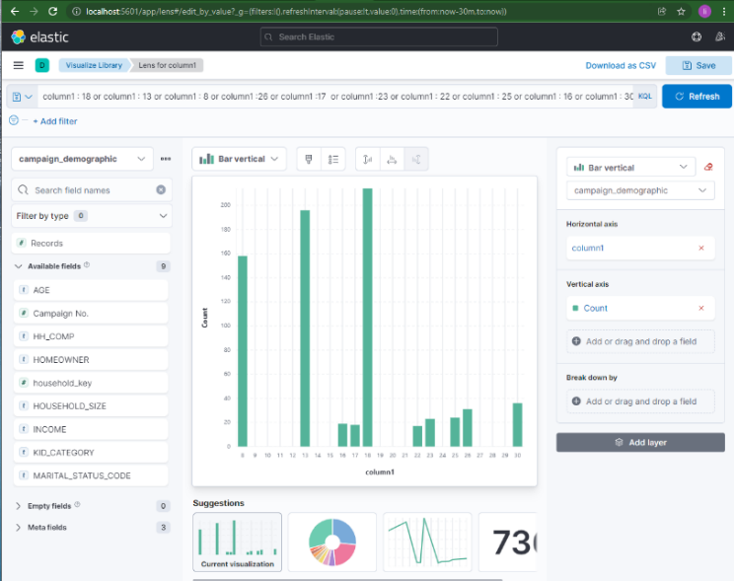
What are the characteristics of customers who were attracted by each marketing campaign?
Datasets : hh_demographic.csv, coupon_redempt.csv
Tools:
Pyspark : create tables, query tables, output csv file
Hadoop Distributed File System (HDFS) : store distributed data, output query result
Kibana: visualize query result
Find campaigns with customer demographic
Pyspark: Group data by campaign number and household ID
(coupon_redempt.csv), Link to custom demographic
(hh_demographic.csv)
HDFS: Write query result into csv file. Merge and output
result files from HDFS to local directory.
Kibana: Import query result into Kibana. Set up Elasticsearch
index pattern. Filter data by searching top 10 campaigns as
we found in previous question, and apply the condition on dashboard.

Slide 10
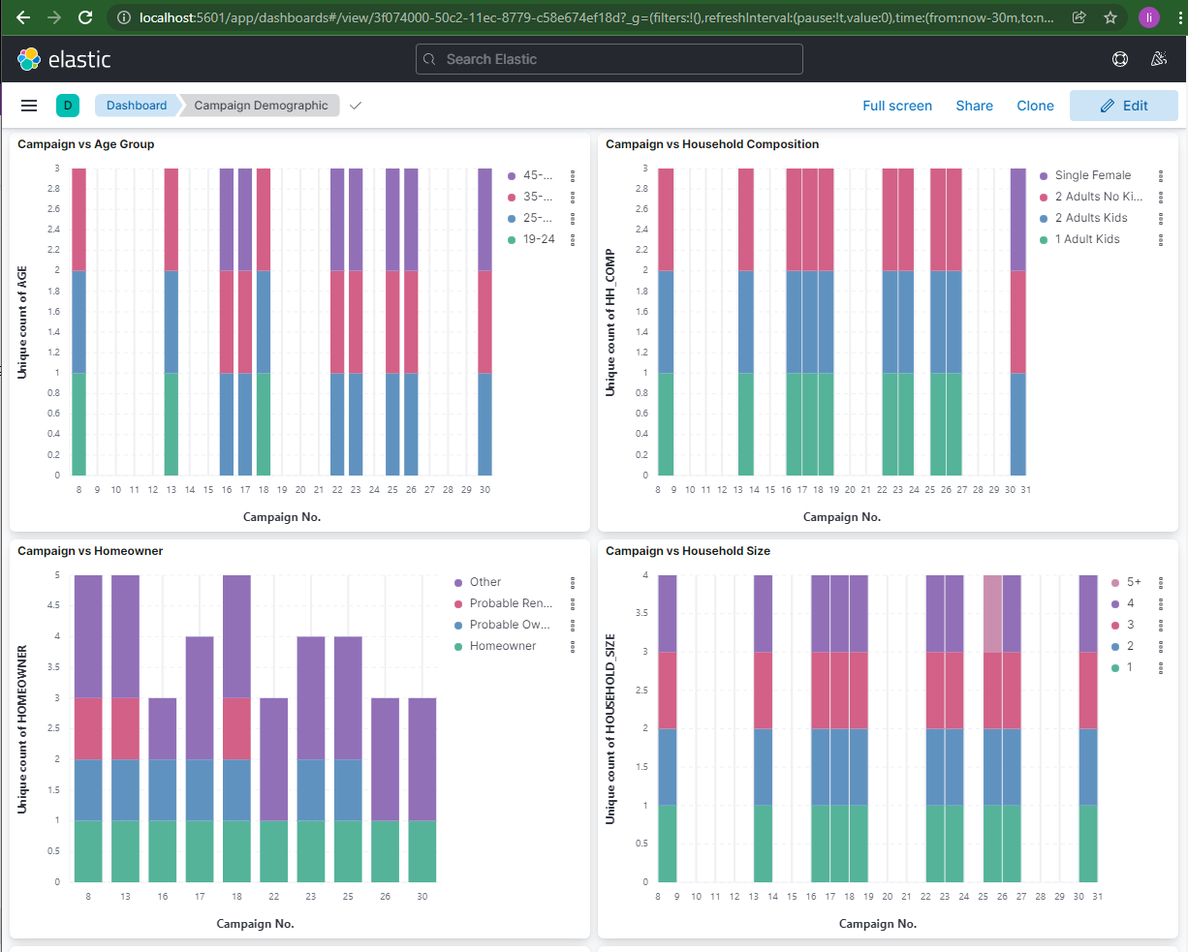
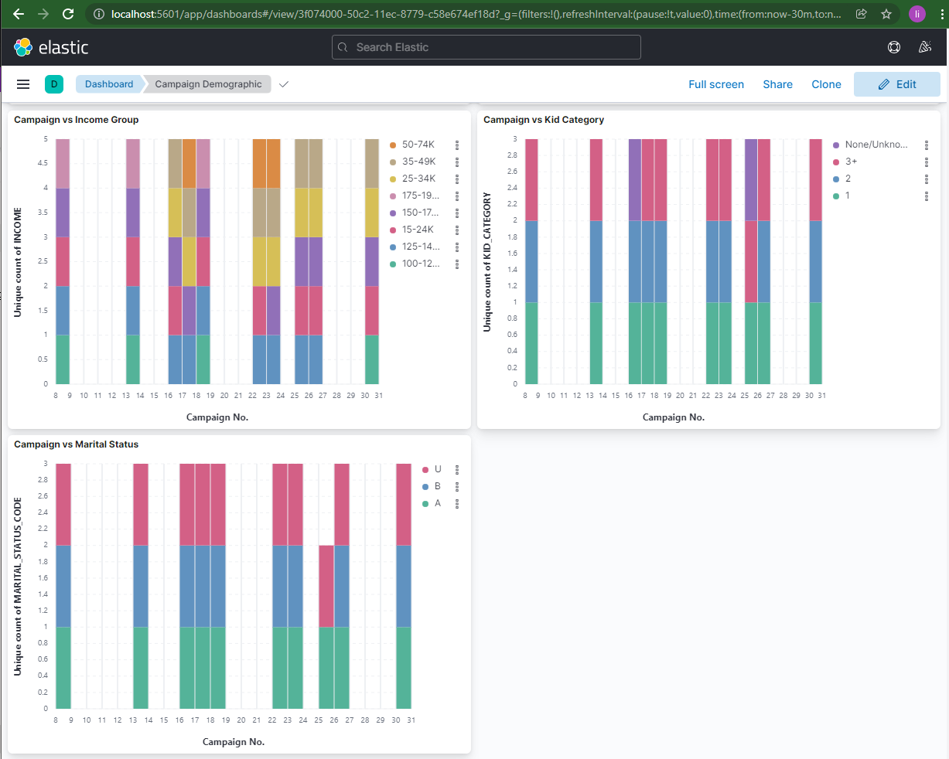
What are the characteristics of customers who were attracted by each marketing campaign?
Insight:
Most of the campaign fans are between the ages of 45-54, have families consisting of two adults with more than three children, rent rather than own, and have incomes between $35k and $49k.

Slide 11
Insights
Mostly the customers who spend more on the store are of 45-54 year age group have kids and are married. It could be the reason behind the higher sales of the grocery items in the stores.
As the grocery covers around 50% of total sales and store has $24,740.1 dollar of highest sale in a day, the store need to originate up with the more ideas to increase the sales of other product.
Marketing campaigns are more effective on higher price products due to the larger increase of sales than quantities.
The campaigns with optimal performance mostly last about 45-50 days. We don’t recommend more than 55 days.
Customers between age above 45, with three more children, and income between $35k and $49k are more likely to enrolled in the marketing campaigns.

Slide 12
Lessons we learned
When joining tables with many_to_many keys, care should be taken with adding join keys to ensure that no more records are created to avoid expanding the total values.
More query problems are best served by Hive, as it is an SQL interface operating on Hadoop. Obviously, it has its own database to store structured tables.
Spark supports programming languages like python, making it easier and faster to do data analysis. For example, writing output to a csv file is much easier than Hive. However, it works with RDDs instead of tables, and we should convert them to views before querying.
Kibana has limit on importing local files (not larger than 100MB), so it is better to import query results for visualization.

Slide 13
Future work
We will consider causal dataset to exclude the effects of other occurring events, such as in-store display, weekly mailer, for each campaign.

Slide 14
Thank you !

